Slide 1
Housing in Orange County, FL
A project for UCF’s Data Analytics & Data Visualization Bootcamp.
Created by: Cindy Gorbas, Elizabeth Jaye, Dinielle Nelson, Robert Perron, and Dolly Vickers

Slide 2
Motivation & Summary

Slide 3
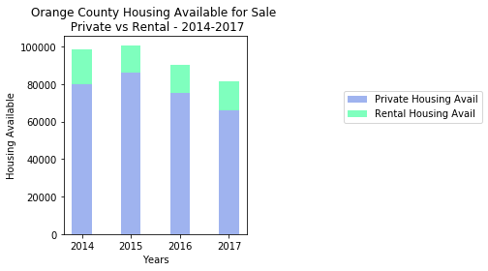
Question 1: Availability

Slide 4
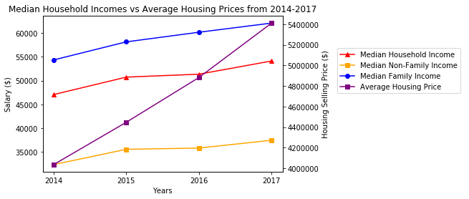
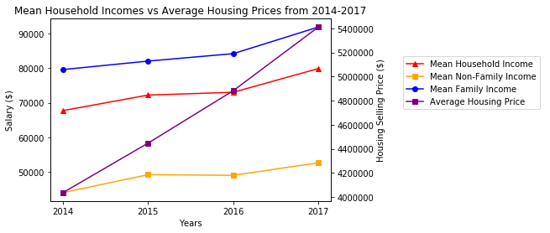
Question 2: Affordability

Slide 5
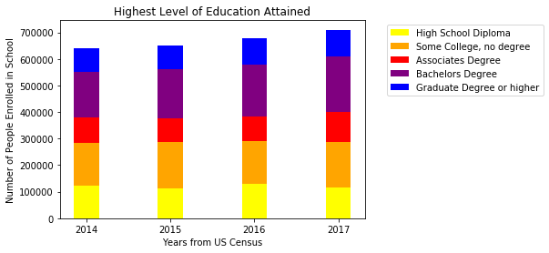
Question 3: Demographic Changes
Education

Slide 6
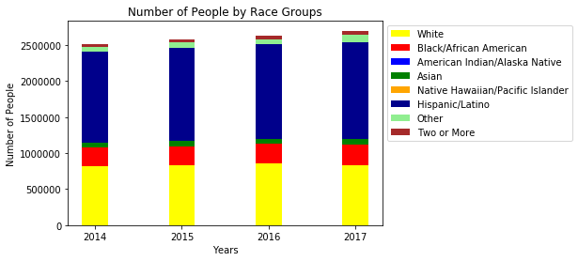
Question 3: Demographic Changes
Race

Slide 7
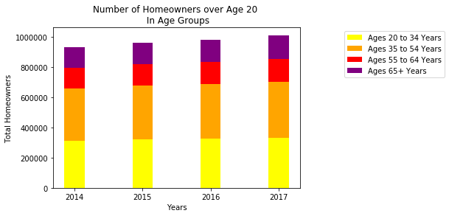
Question 3: Demographic Changes
Age Range

Slide 8
Data Cleanup & Exploration
Methods of data collection including .csv pulls from the Multiple Listing Service (MLS) database and API pulls from the US government’s American Community Survey census.
Data clean up involved limiting year ranges based on overlap between two datasets, as well as targeting what was relevant and targeted in mass of data.
Surprising elements were the consistencies in demographics over time (though admittedly our year range is limited) and the discrepancy between family and non-family incomes.

Slide 9
Post Mortem
Discuss any difficulties that arose, and how you dealt with them
Discuss any additional questions that came up, but which you didn't have time to answer: What would you research next, if you had two more weeks?
Basically acknowledge limitations

Slide 10
Questions & Answers

